Slide 1
AI Augmented Project Management
an IOD-Capstone Project Presentation by Lawrance Koh, CITPM, PMP, CSM, ITIL
on 26-Jun-2021 1:30pm

Slide 2
About Lawrance Koh
CITPM, PMP, CSM, ITIL Certified
15+ years experience in project management
8+ years experience in business management
BSc Computer & Information Systems
https://www.linkedin.com/in/lawrancekoh/

Slide 3
About Today’s Audience
Most have minimal reference to professional project management
Few project management subject experts

Slide 4
Agenda
Background
Capstone Project Scope
Recommendations / Next Steps

Slide 5
Background
Problem Statement
Observations
Domain & Assumptions
Scope & Stakeholders
Objectives
For context

Slide 6
Problem Statement(s)
One of the black arts of project management is predicting the future, where we represent this future state as a new project plan. We draw upon our own domain and company experience to determine the steps, resources and time needed to accomplish the goal. Our success rate at predicting the future is not good.
Our predictions are fraught with error due to the limits of our experience and that of the organization.

Slide 7
Observations
State of the Industry (Small / Medium Enterprise and/or Startups):
Assortments of tools / unstructured information silos
Haphazard project management “methodologies”
Low visibility of project performance, resources allocations / availability

Slide 8
Domain & Assumptions
Software Development domain
Projects are managed collectively, generally in a standardised manner

Slide 9




Scope & Stakeholders
Project Manager
Cost, Schedule, Scope, Quality, Resource, Estimates, Planning, Risks, Stakeholders, Communications
Sales, Quotation, Pricing
Tasks, Timelog
Sales Team
Development Team
Profits
Business
Management

Slide 10
Objectives
Streamlined, integrated best practices, data-driven project management.
“With the interdisciplinary nature of the project management, it is unlikely for it to be fully automated in the near future. But elements of the process or single tasks can be augmented today.”

Slide 11
Capstone Project Scope
The Engineering
The Modelling
The Training
The Results
NLP recognition of tasks

Slide 12
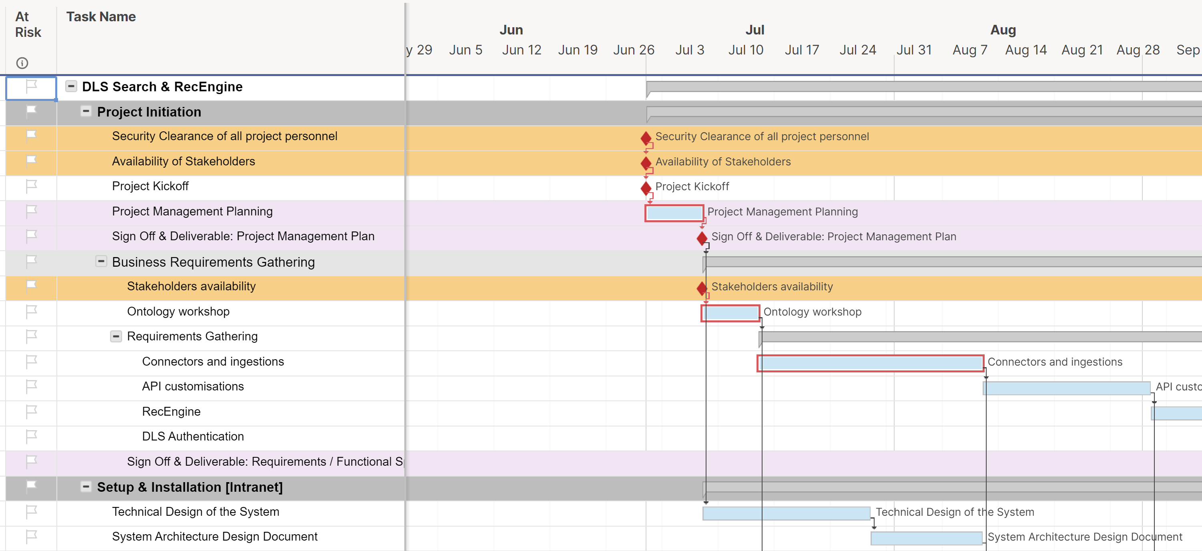
The Engineering
Raw data collected
Referenced / Copy Gantt Charts
1,395 rows
Sanitisation (remove confidential info)
Manual tagging of tasks to labels

Slide 13
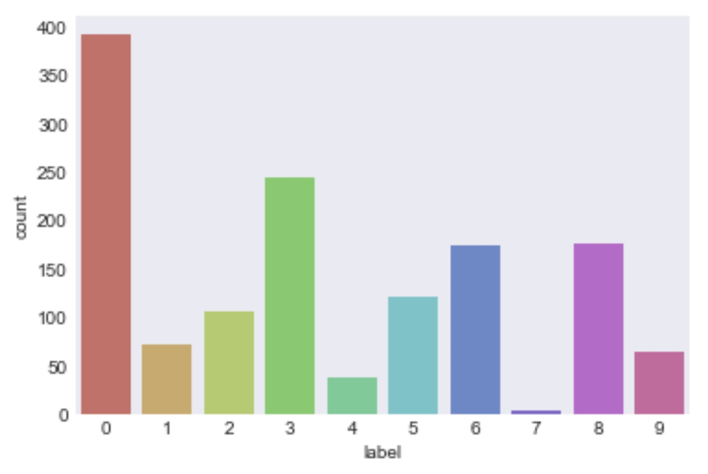
Labels Distribution

Slide 14
The Modelling
MultiNomial
Naïve Bayes
RandomForest
GradientBoosting
LogisticsRegression
Spacy
TFIDF vectorizer
Ensemble Classification
Stacking

Slide 15



The Training
Naïve Bayes (Multi-Nomial)
RandomForest
GradientBoosting

Slide 16
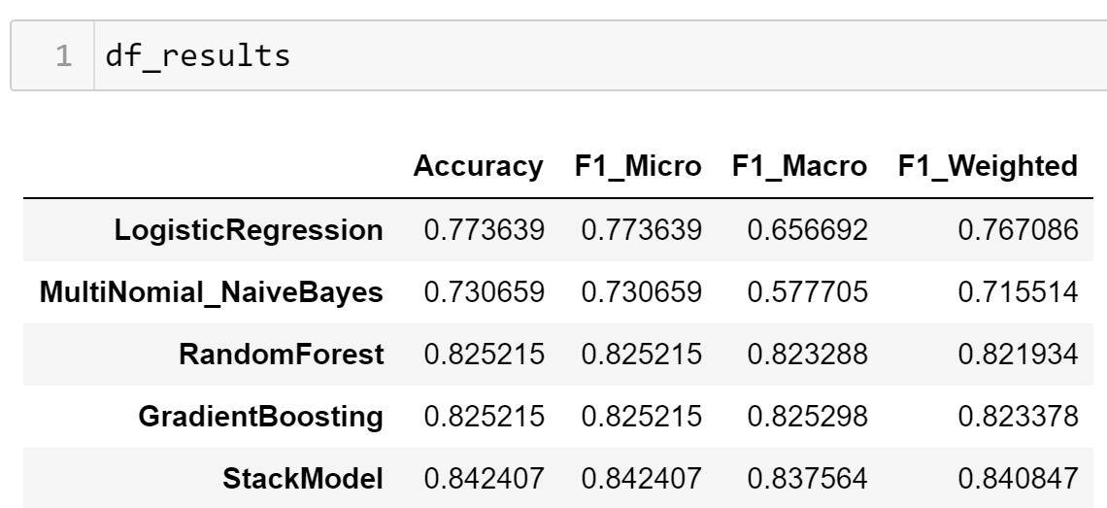
The Results

Slide 17
Reading into The Results
Sufficiently high accuracy of identifying tasks to corresponding tag
>80% accuracy acceptable in practical real life applications [benchmark / expectations]

Slide 18
Recommendations / Next Steps
For the data
For the model
For the solution

Slide 19
For the Data
Increase data sources
Sales proposals / quotations
Time-log
Increase granularity of tagging / labels
SMOTE sampling to balance labels

Slide 20
For the Model
Further improve accuracy of current model
Fine tune hyperparameters of each classifer
Replace and/or use more classifiers to stack
Using BERT as an alternative model for comparison
With Convolution Neural Network (CNN)

Slide 21
For the Solution
Data Analytics Dashboard
Webpage / Webapp / Webportal
Recommender
based on NLP and analytics
Aggregated data based on the granular labelled tasks
Integration with popular time-log software (e.g. Jira)
Chatbot deployment (e.g. Slack)

Slide 22
For the Solution – cont.
Auto-tagging
Auto-generate Gantt-Charts
Auto Suggest Reminders, Action-Items or Tasks

Slide 23
“What get measured, gets managed.”
– Peter Drucker

Slide 24
Thank You!
Questions?

Slide 25
References
3 ways AI will change project management for the better
https://www.atlassian.com/blog/software-teams/3-ways-ai-will-change-project-management-better
5 benefits of Artificial Intelligence in Project Management
https://www.softwareadvice.com/resources/artificial-intelligence-project-management-benefits/
AI In Project Management
https://www.forbes.com/sites/cognitiveworld/2019/07/30/ai-in-project-management/?sh=7fae2fb0b4a0
AI In Project Management - The Humble Road To The Bright Future
https://www.ideamotive.co/blog/ai-in-project-management-the-humble-road-to-the-bright-future
Artificial Intelligence for the Real World
https://hbr.org/2018/01/artificial-intelligence-for-the-real-world

Slide 26
References – cont.
Four Ways AI & Bots Will Change Project Management
https://www.clarizen.com/ai-bots-project-management/
How AI could revolutionize project management
https://www.cio.com/article/3245773/how-ai-could-revolutionize-project-management.html
The augmented project manager
https://www.cio.com/article/3050325/the-augmented-project-manager.html
The Role of Artificial Intelligence in Improving Project Management
https://www.ligsuniversity.com/en/blogpost/the-role-of-artificial-intelligence-in-improving-project-management
The top 9 reasons for IT project failure: Is your project at risk?
https://www.atspoke.com/blog/it/reasons-for-it-project-failure/

Slide 27
Source
Source Description | Attachment
Source code (Jupyter Notebook)
Data (Excel)

Slide 28
Glossary of Terms & Definitions
PMO: Project Management Office a management structure that standardizes the project-related governance processes and facilitates the sharing of resources, methodologies, tools, and techniques
PV: Planned Value Planned Value (PV) is the authorized budget assigned to work to be accomplished for an activity or WBS component.
EV: Earned Value Earned Value (EV) is the value of work performed expressed in terms of the approved budget assigned to that work for an activity or WBS component.
AC: Actual Cost Actual Cost (AC) is the total cost actually incurred in accomplishing work performed for an activity or WBS component.
BAC: Budget at Completion The sum of all budgets established for the work to be performed.
WBS: Work Breakdown Structure a deliverable-oriented hierarchical decomposition of the work to be executed by the project team to accomplish the project objectives and create the required deliverables

